Slide 1
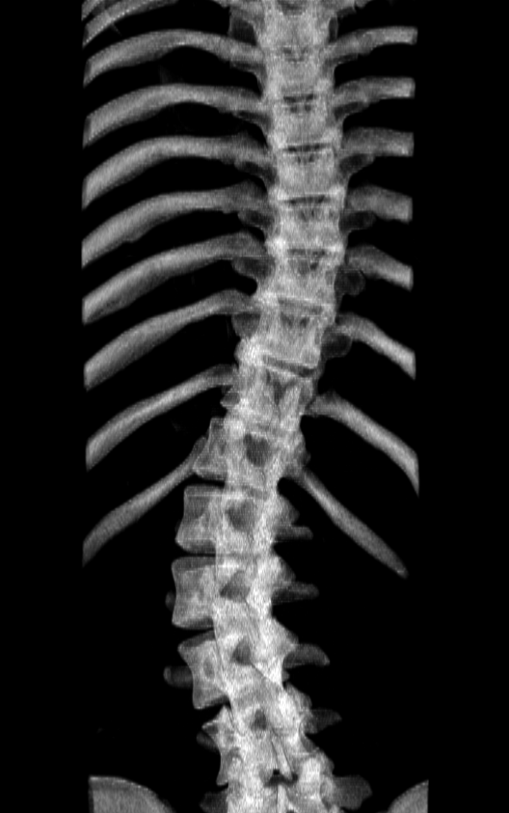

Slide 2
Automatic landmark generation (Ch. 4)
Tracked ultrasound scan (2.3)
Bone segmentation (4.1)
Landmark generation (4.2)
Landmark set repair (4.3)
Scoliosis visualization (Ch. 3)
Healthy-shaped surface and landmarks (3.3)
Thin-plate spline registration (3.4)
Transverse process locations (3.2)
3D surface visualization (3.5)

Slide 3
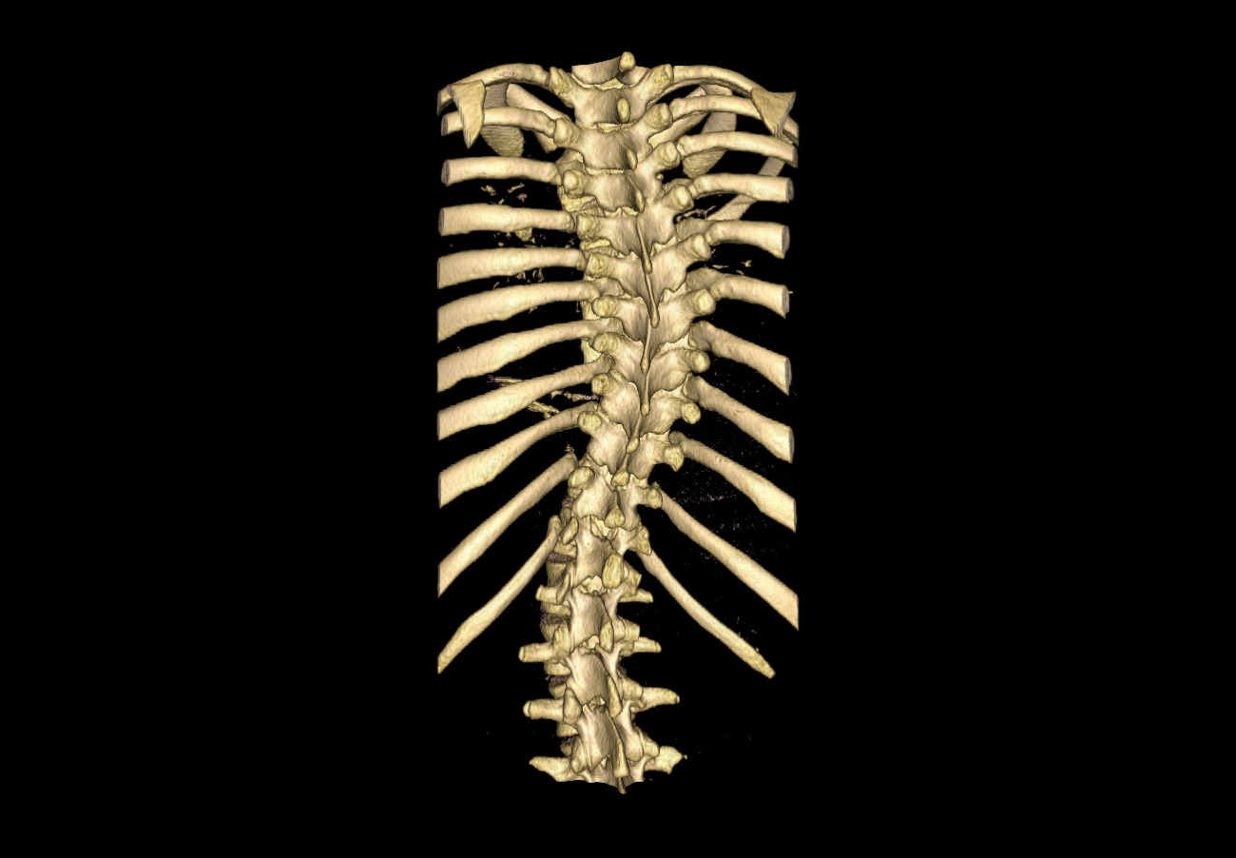
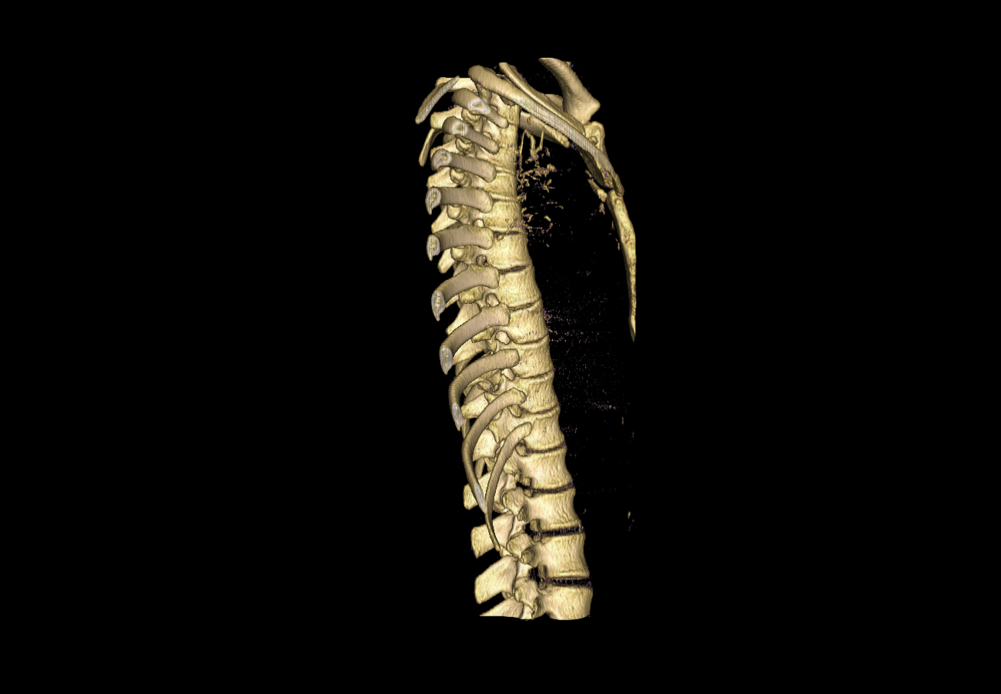

Slide 4
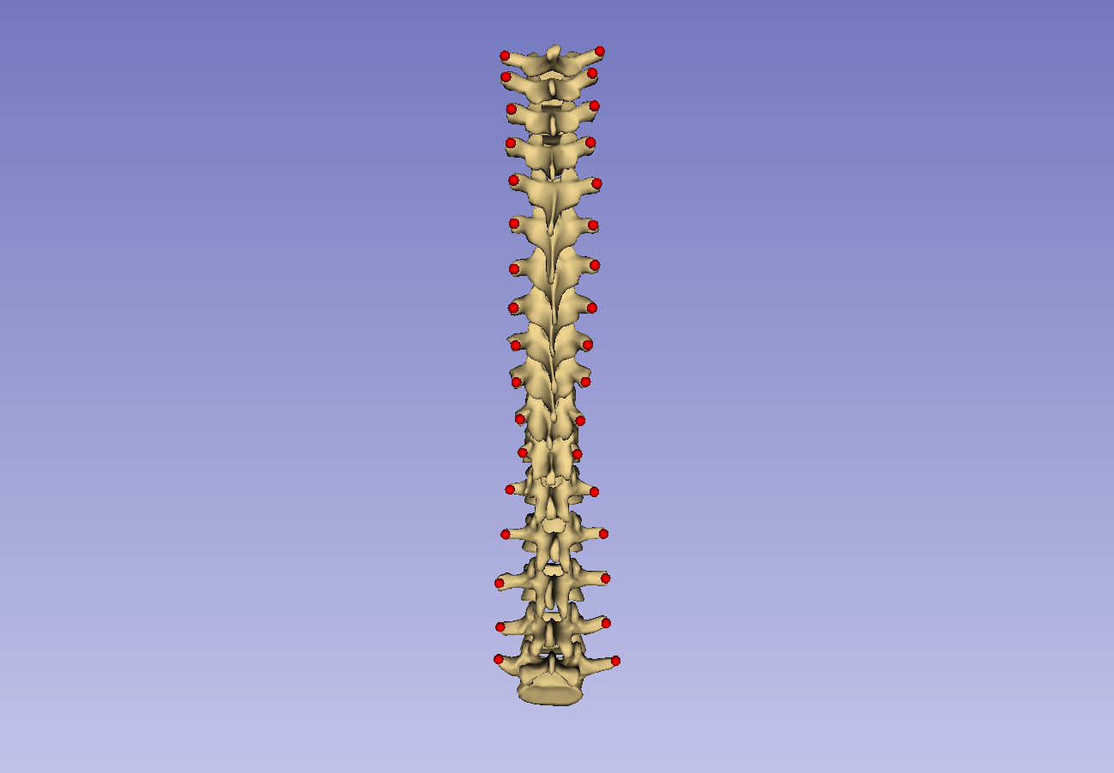
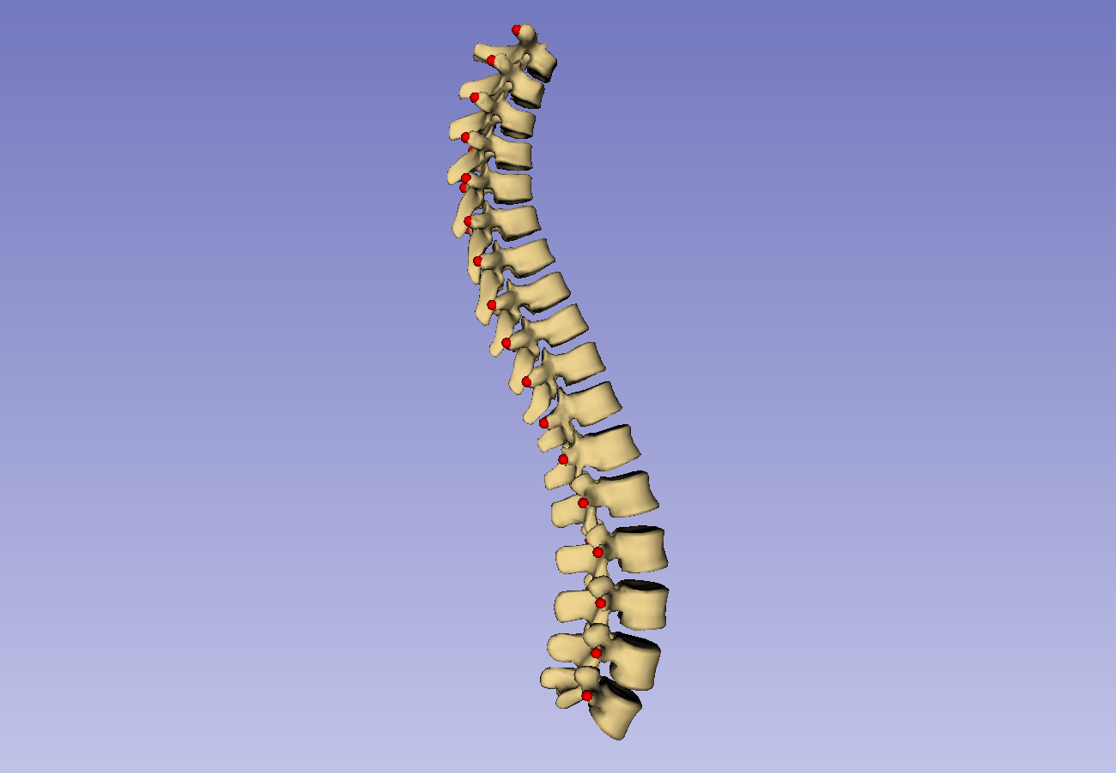

Slide 5
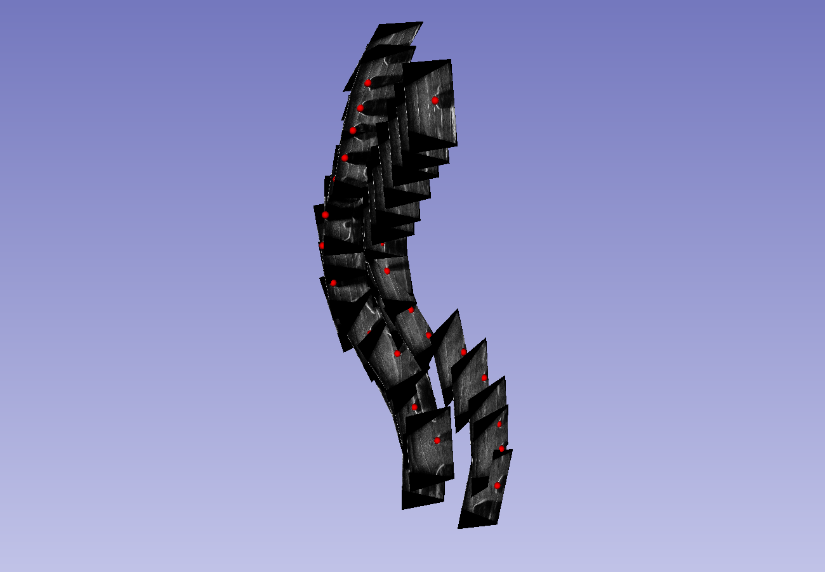
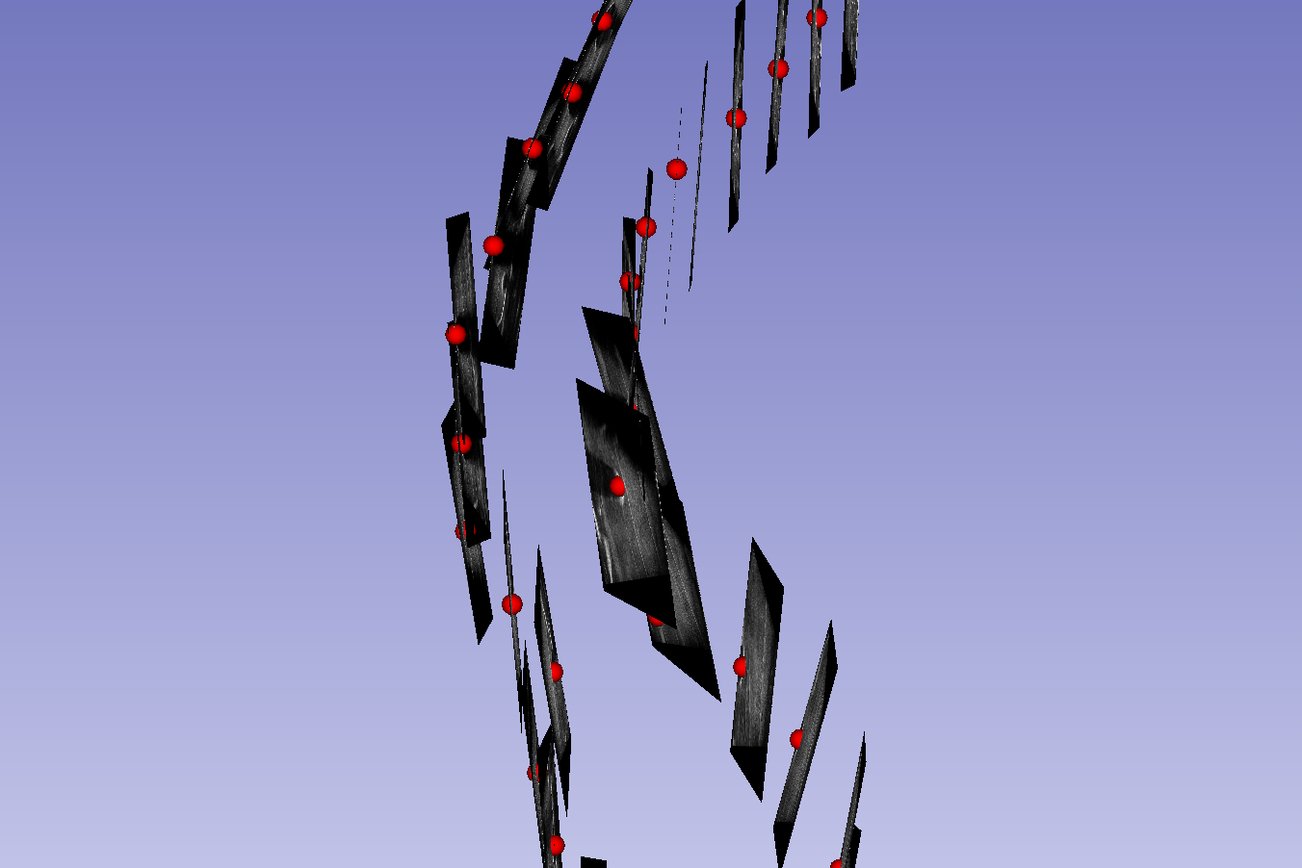
Coronal tilt

Slide 6
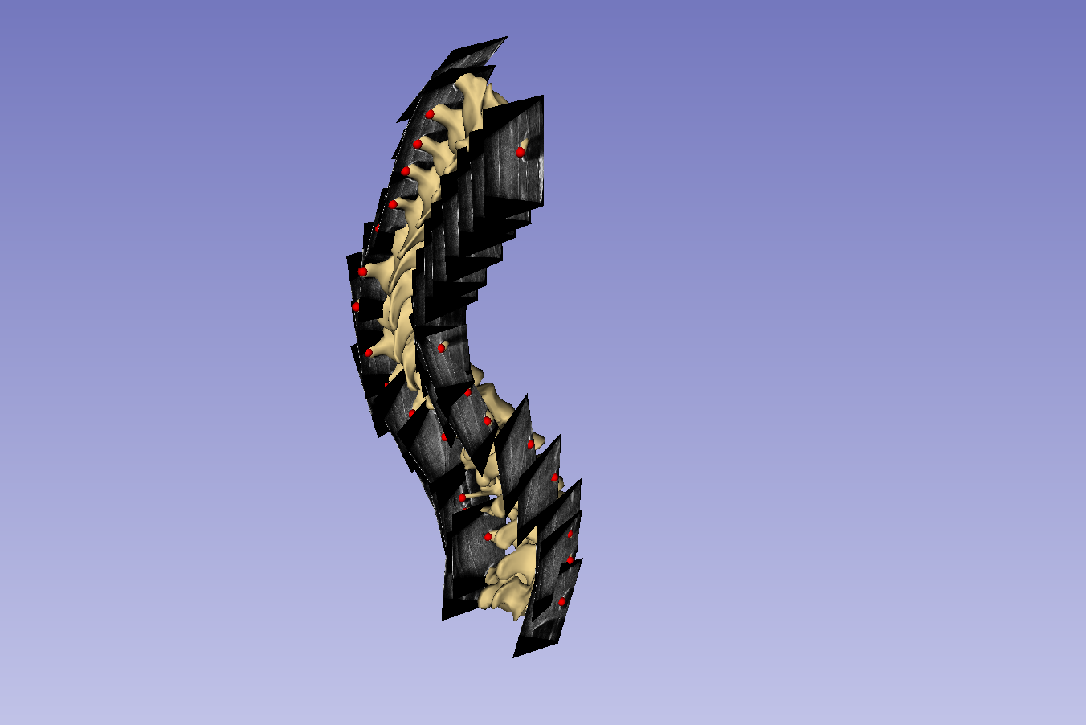
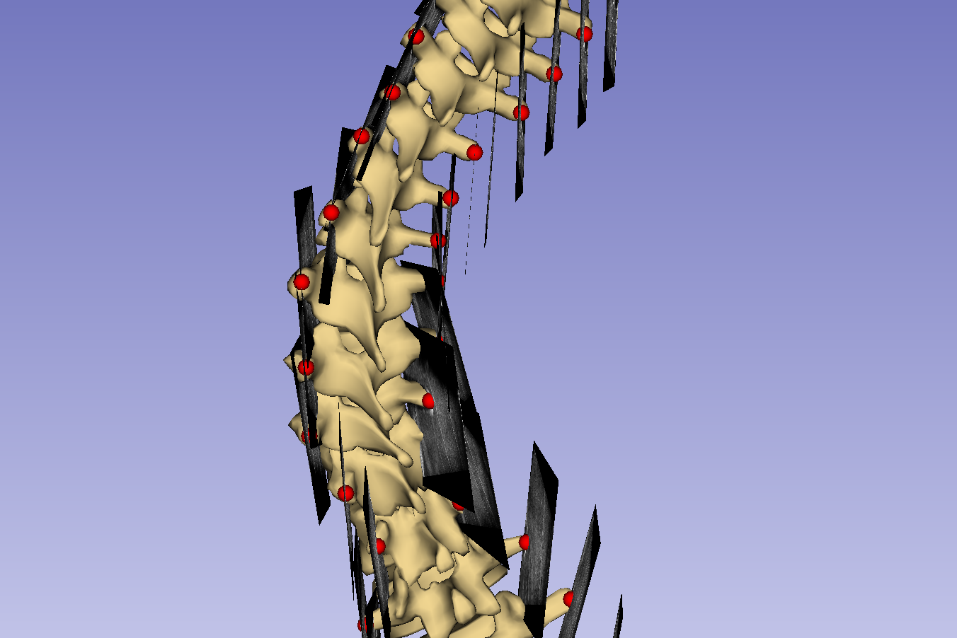
Coronal tilt

Slide 7
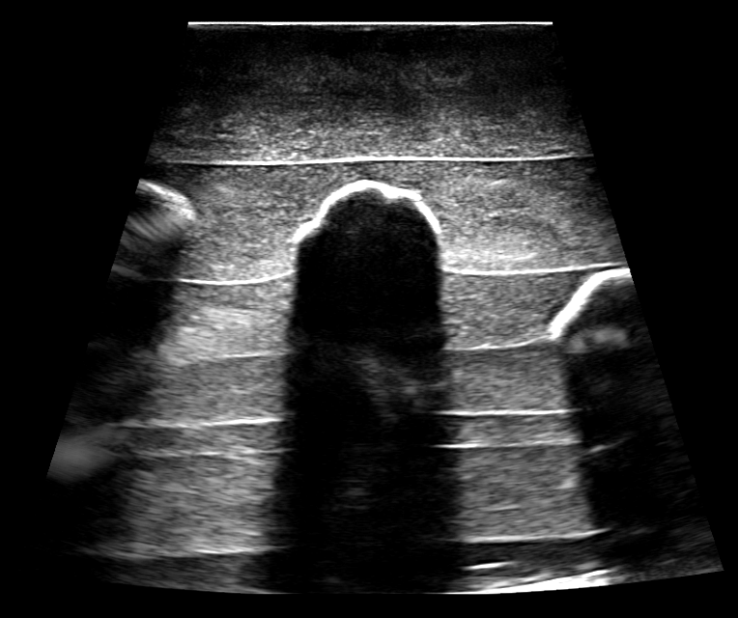

Slide 8
a
b

Slide 9
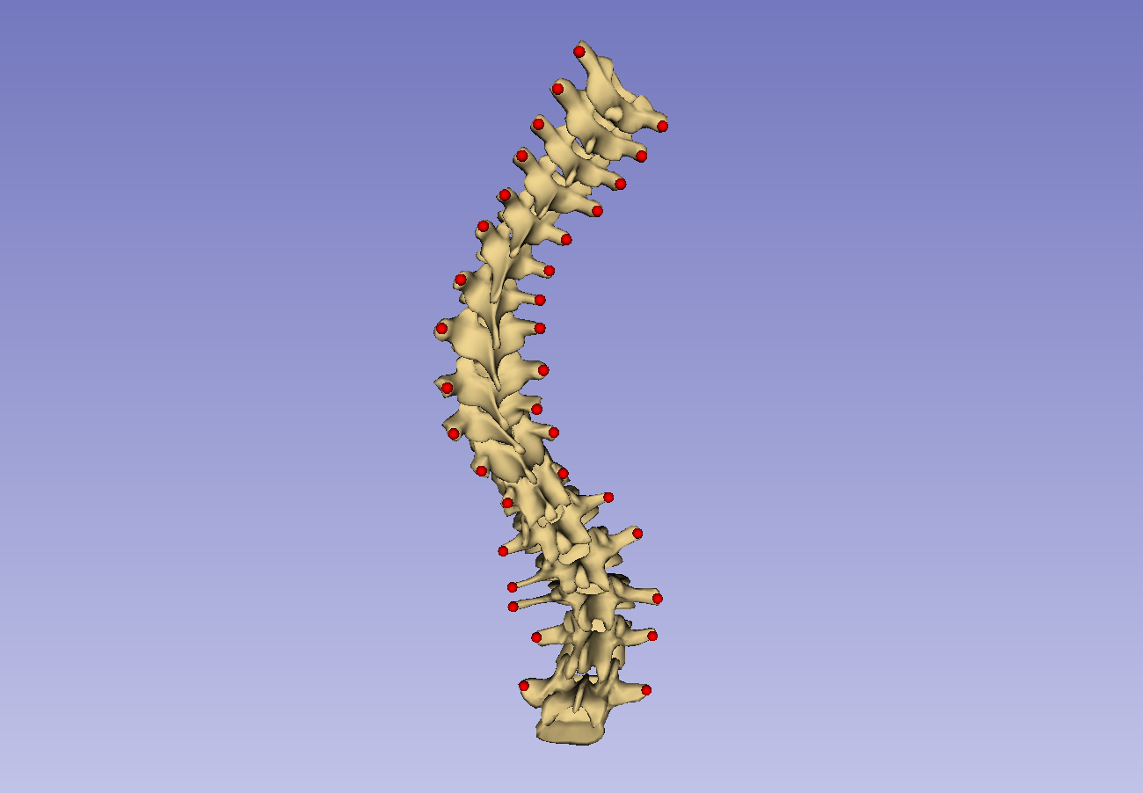
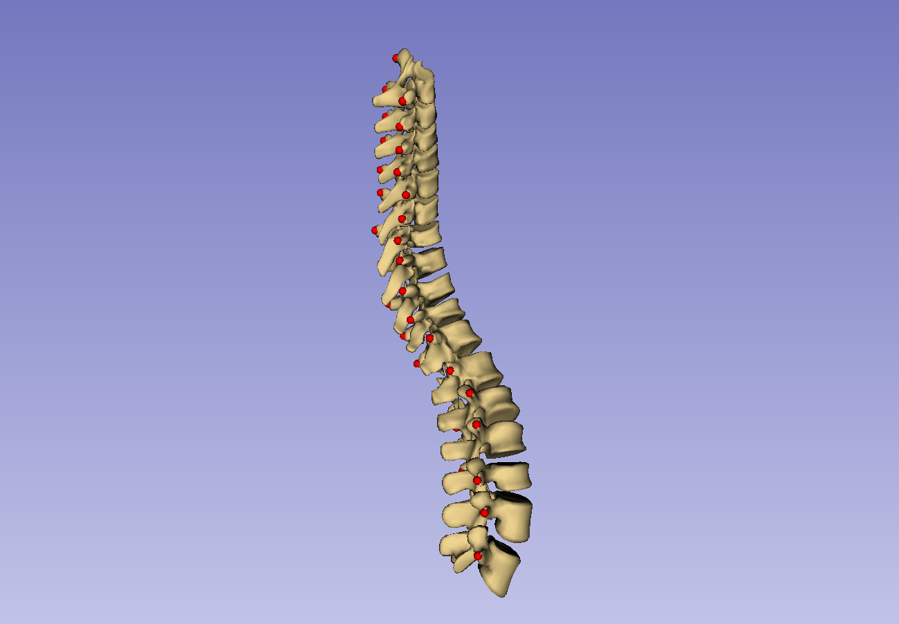

Slide 10
Patient transverse process locations
Anchor point supplementation
Healthy-shaped model: points
Thin-plate spline registration
Healthy-shaped model: surface
Patient registration points
Thin-plate spline transform
Warping transform
Patient-specific visualization

Slide 11
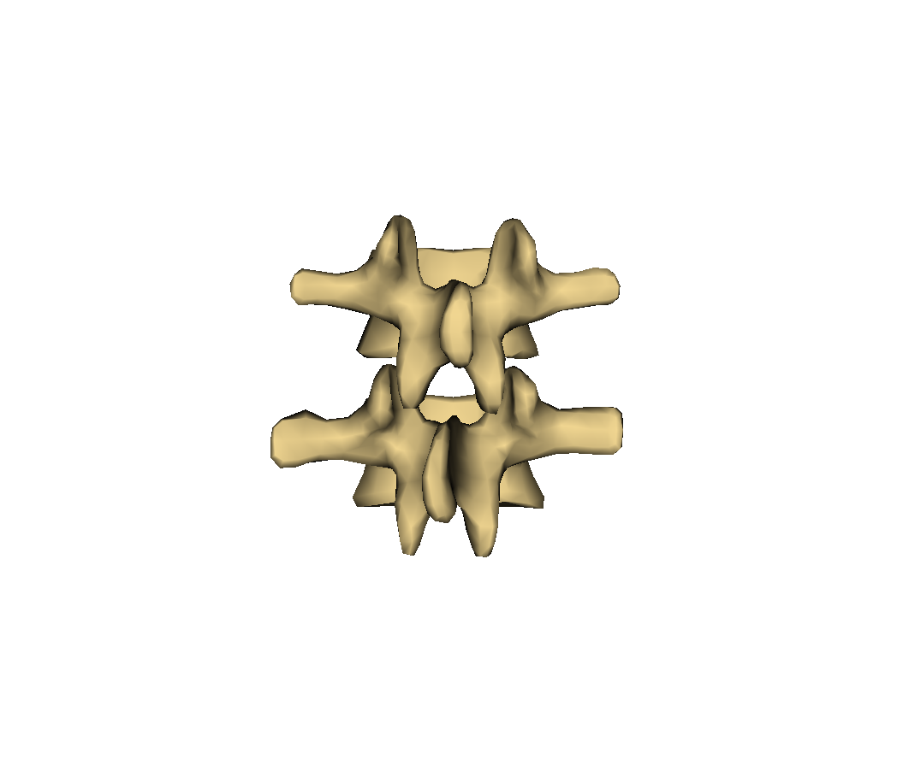
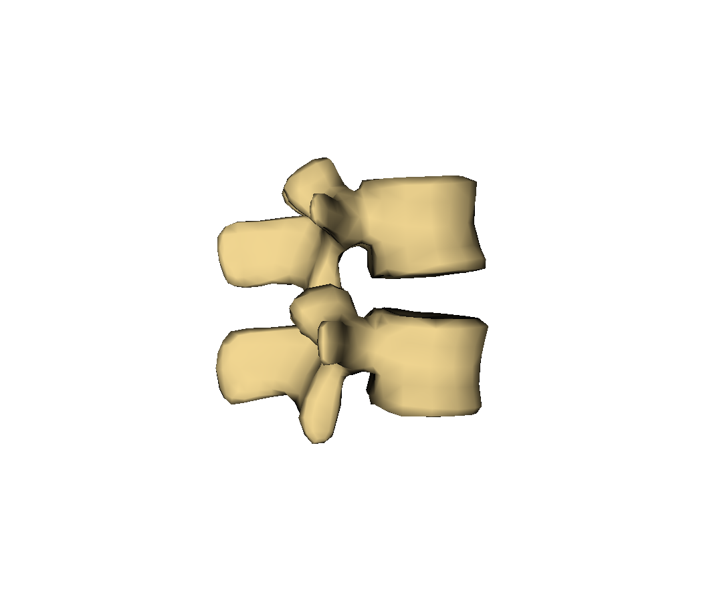
Vertebral body
Transverse process
Superior articular process
Facet joint
Spinous process
Inferior articular process
Lamina

Slide 12
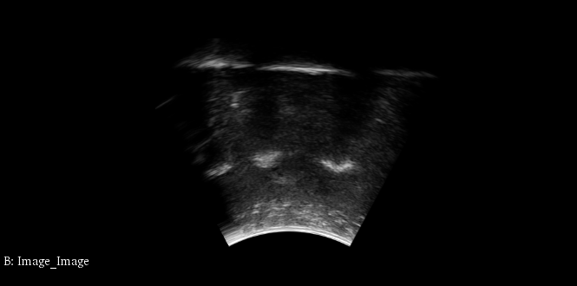
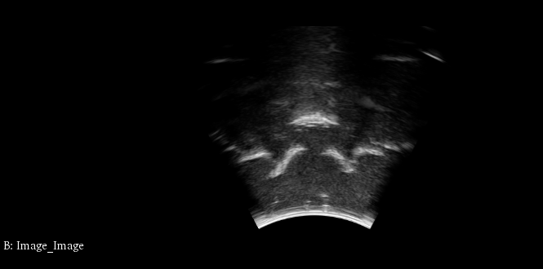
Lam
TP
AP
TP
VB
Legend: TP – Transverse process; VB – Vertebral body; Lam – Lamina; AP – Articular process

Slide 13
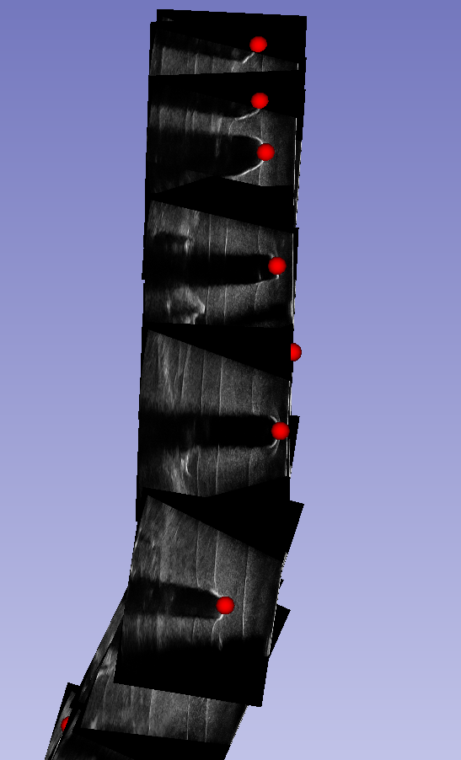

Slide 14
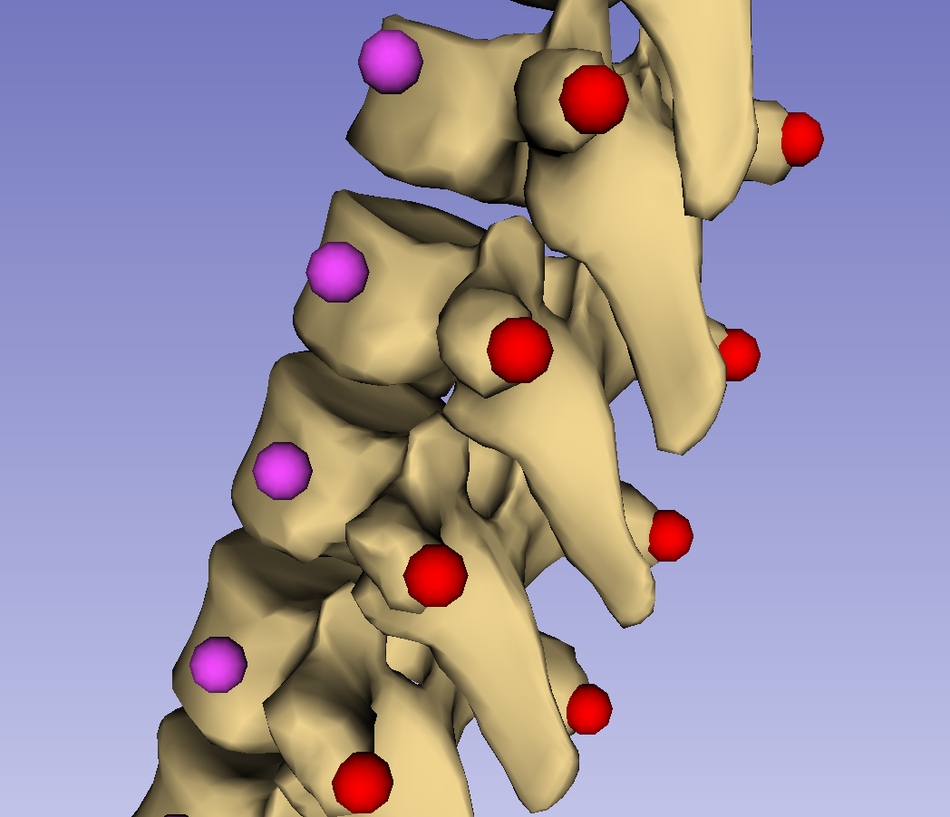
P*(7,0)
<SI(8,0)>
P(7,0)
P(7,1)
<RL(8,0)>
P*(8,0)
<AP(8,0)>
P(8,0)
P(8,1)
P*(9,0)
P(9,1)
P(9,0)

Slide 15
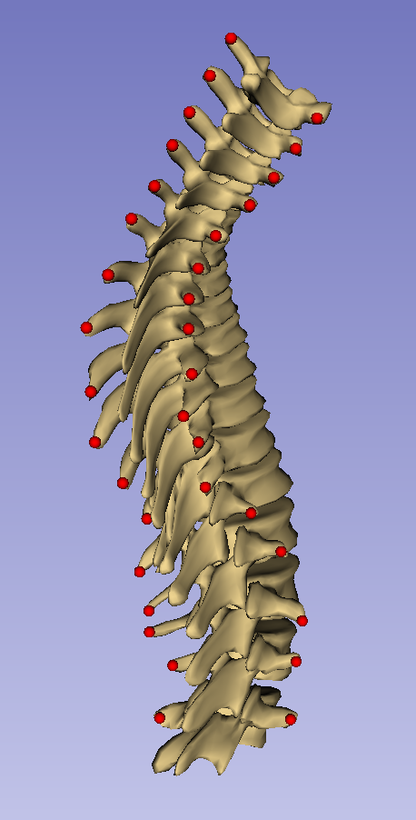
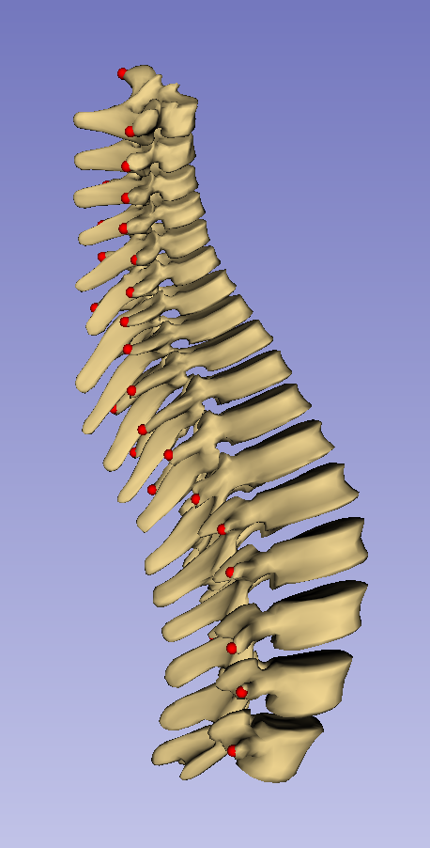

Slide 16
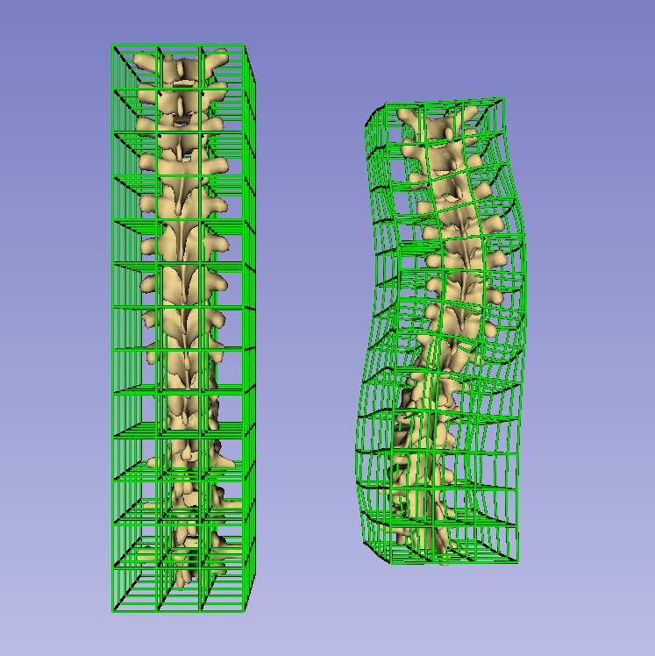

Slide 17
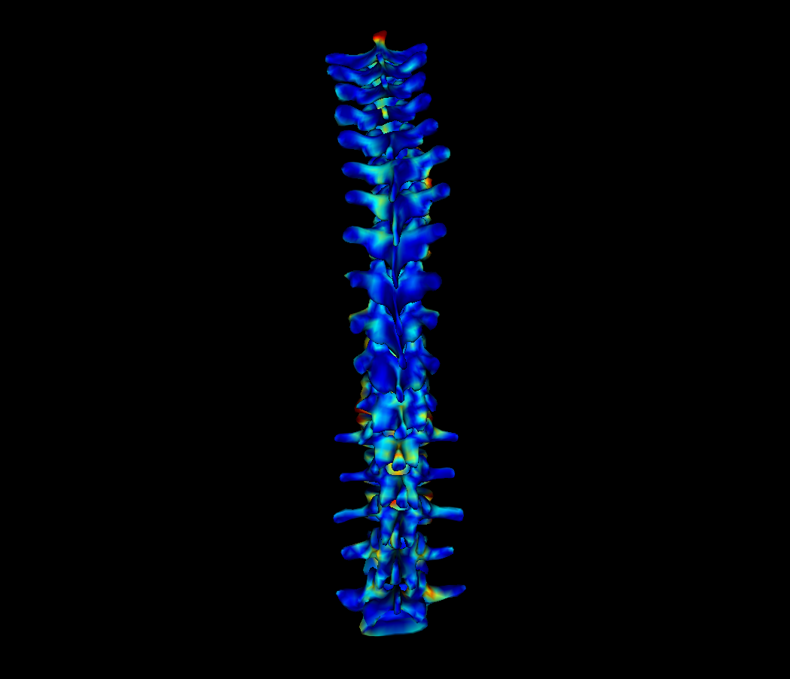
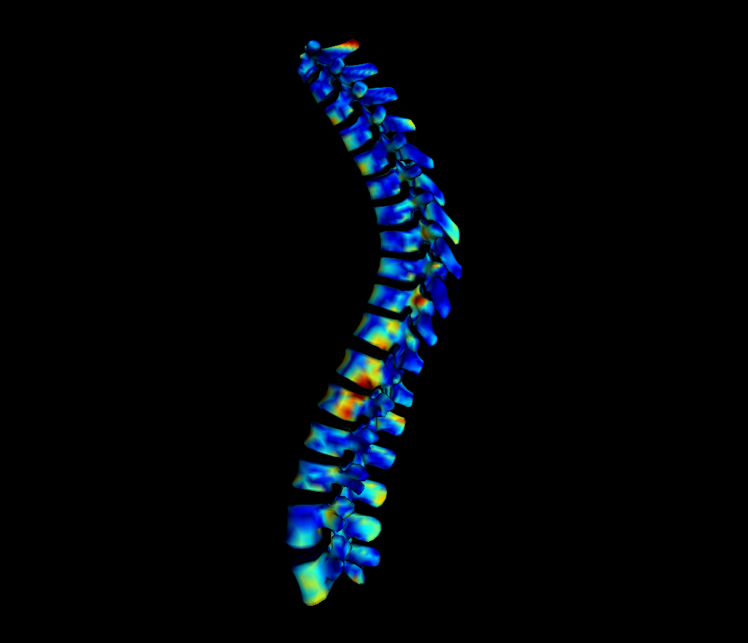
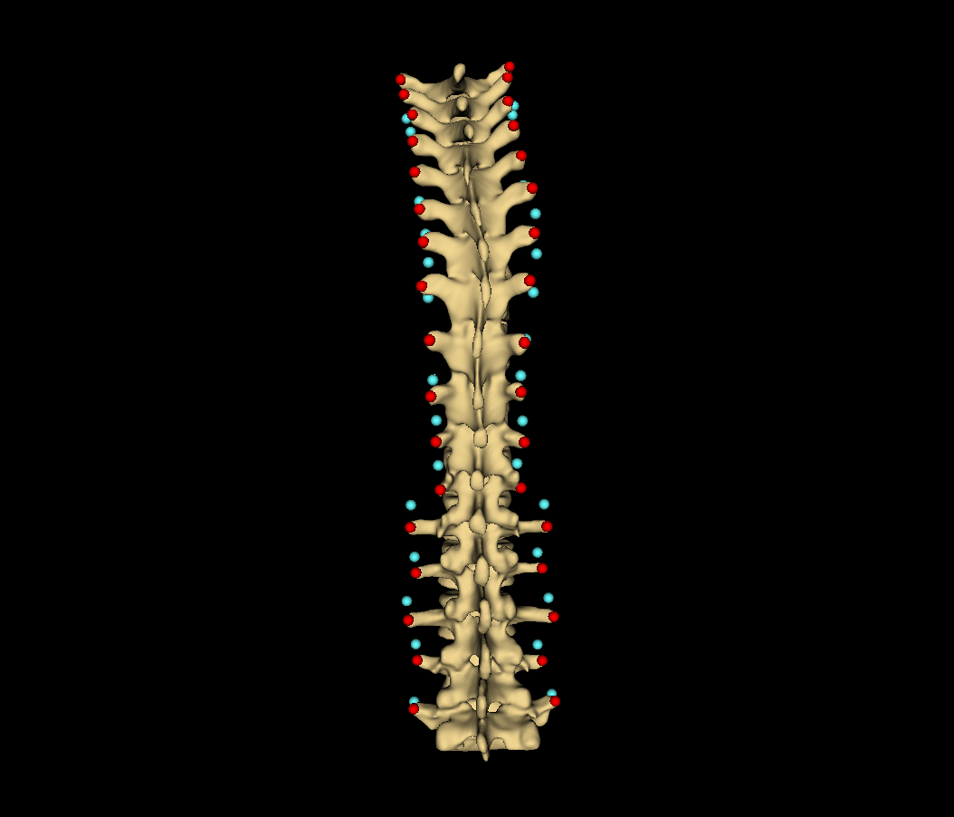
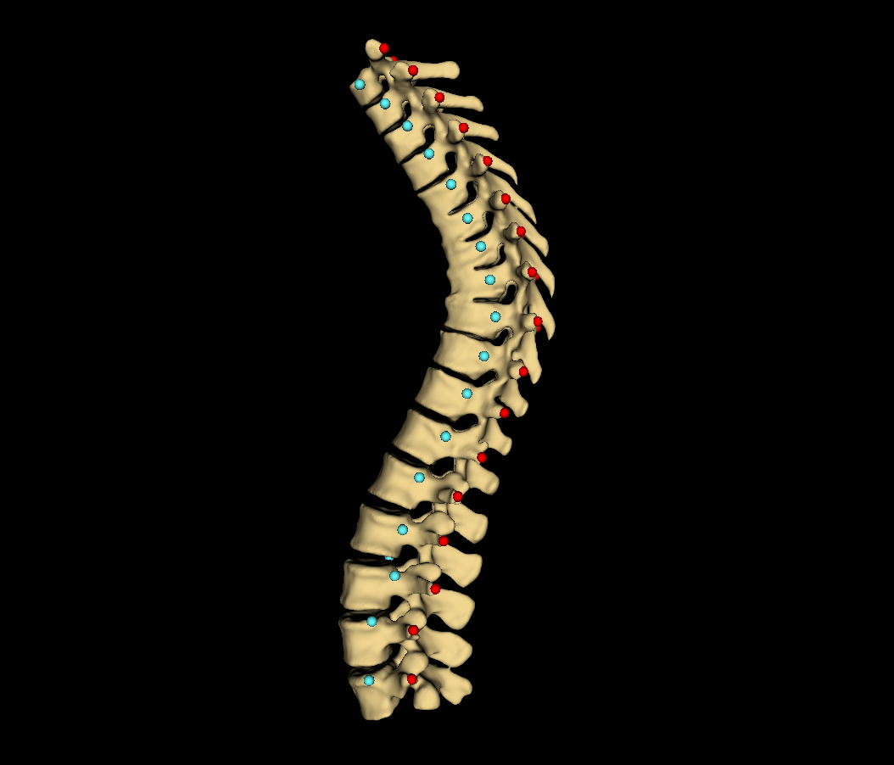

Slide 18
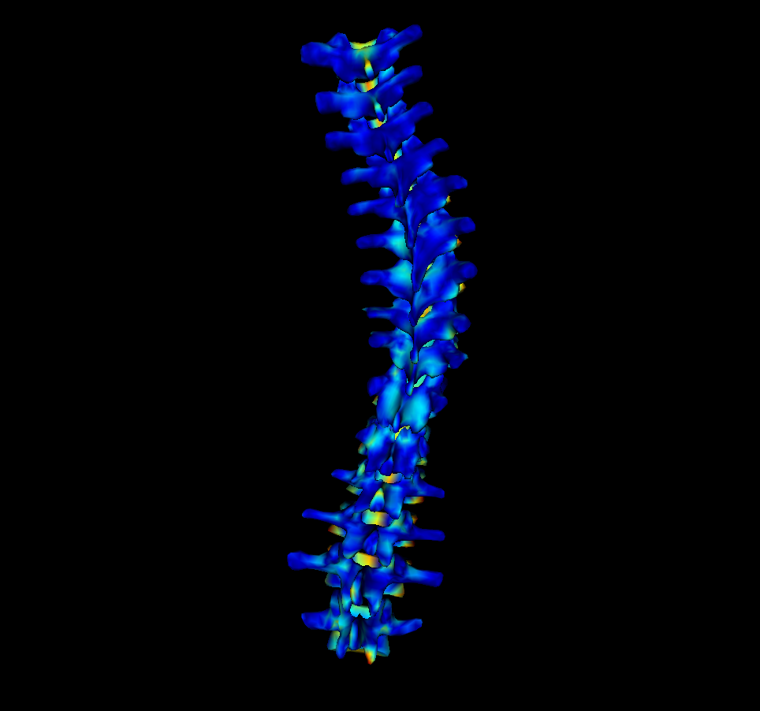
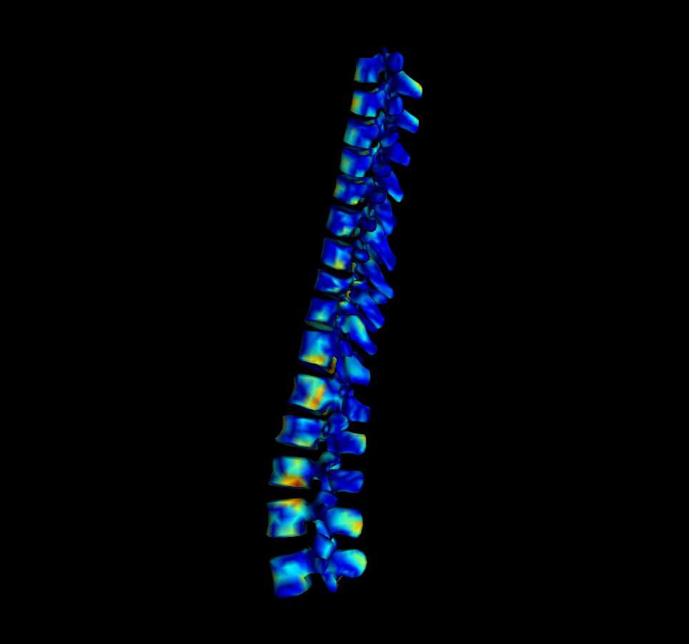
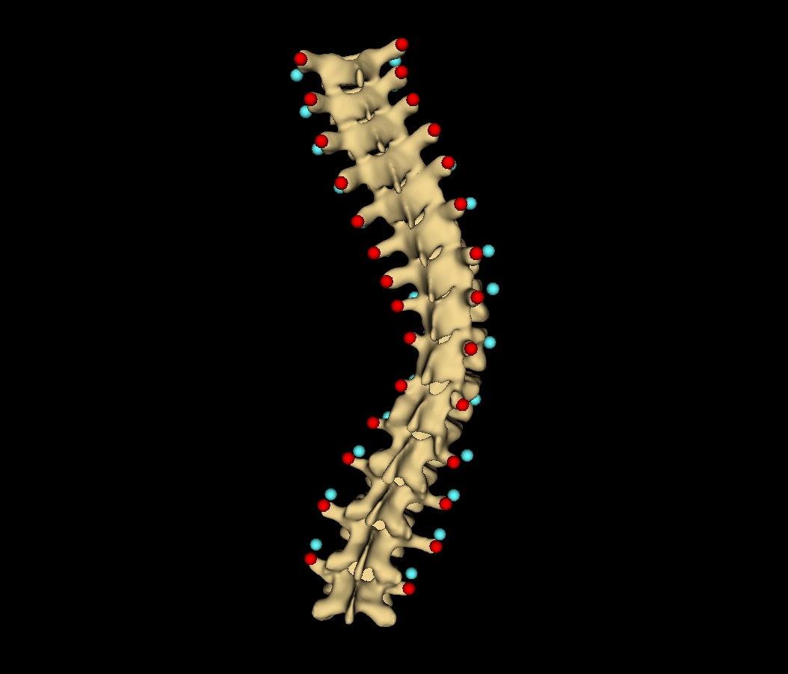
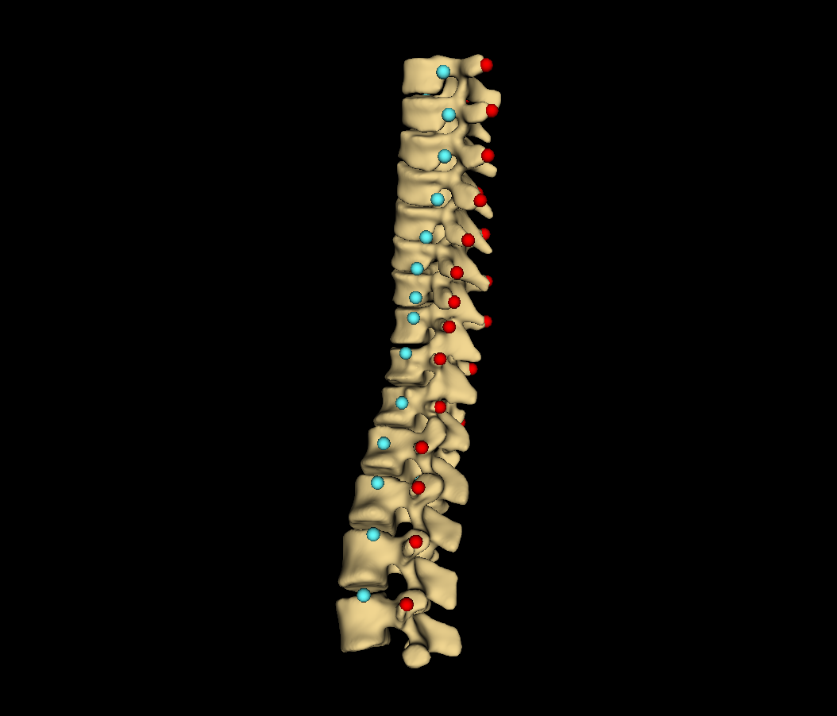

Slide 19
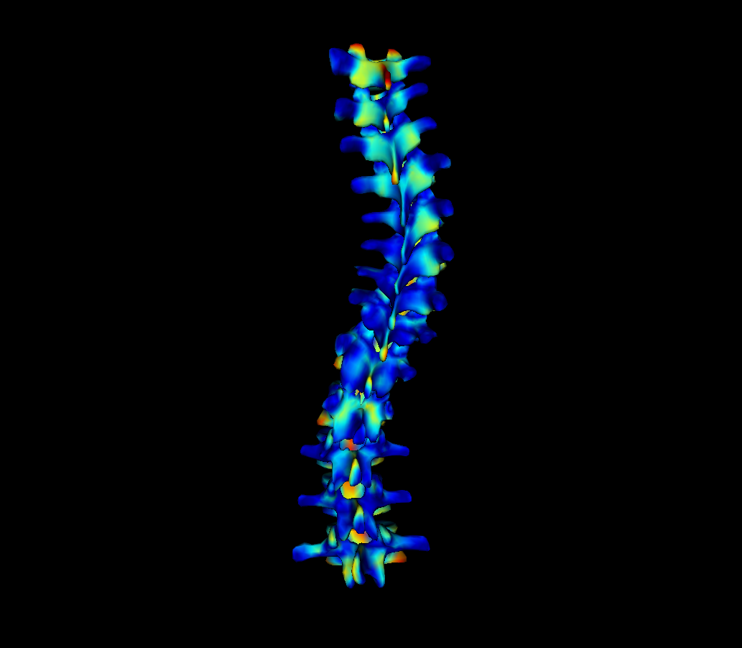
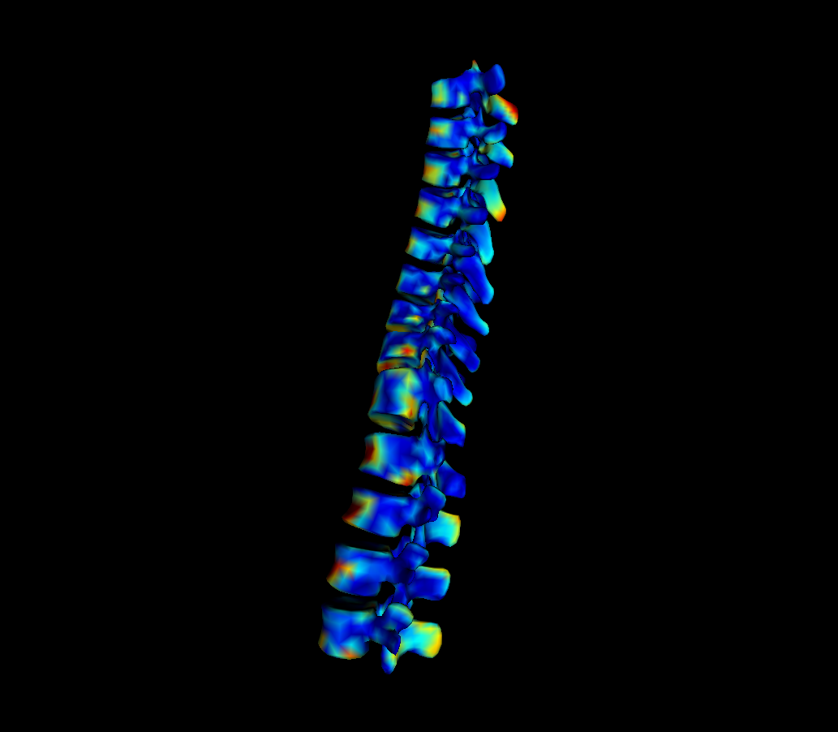
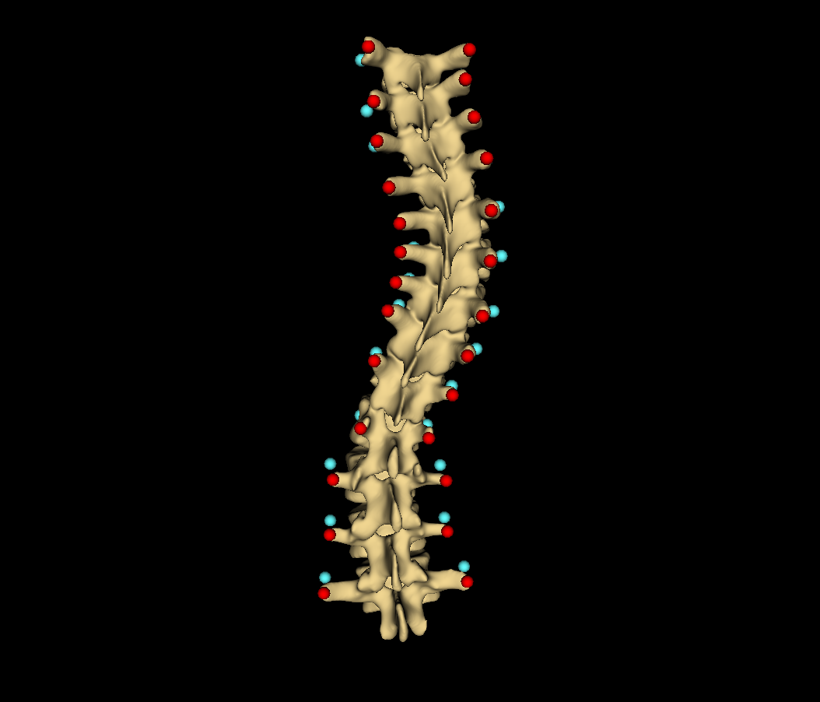
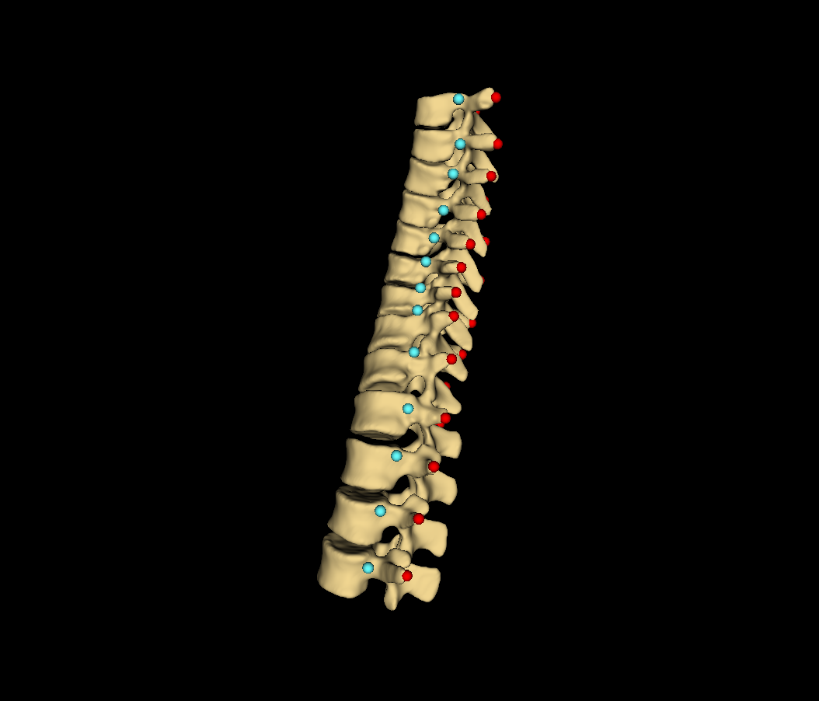

Slide 20
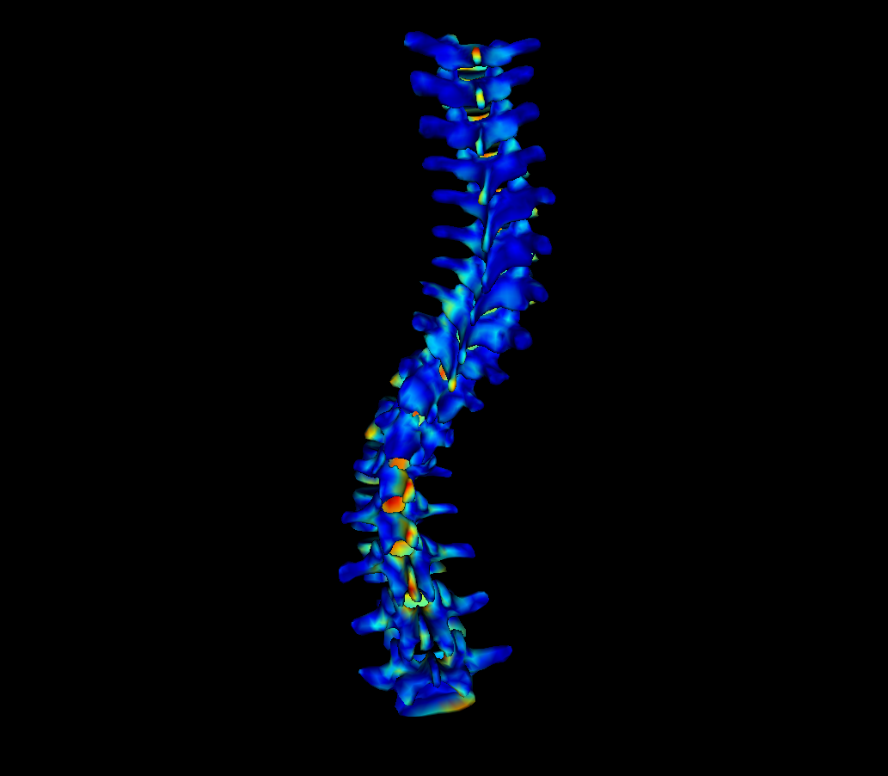
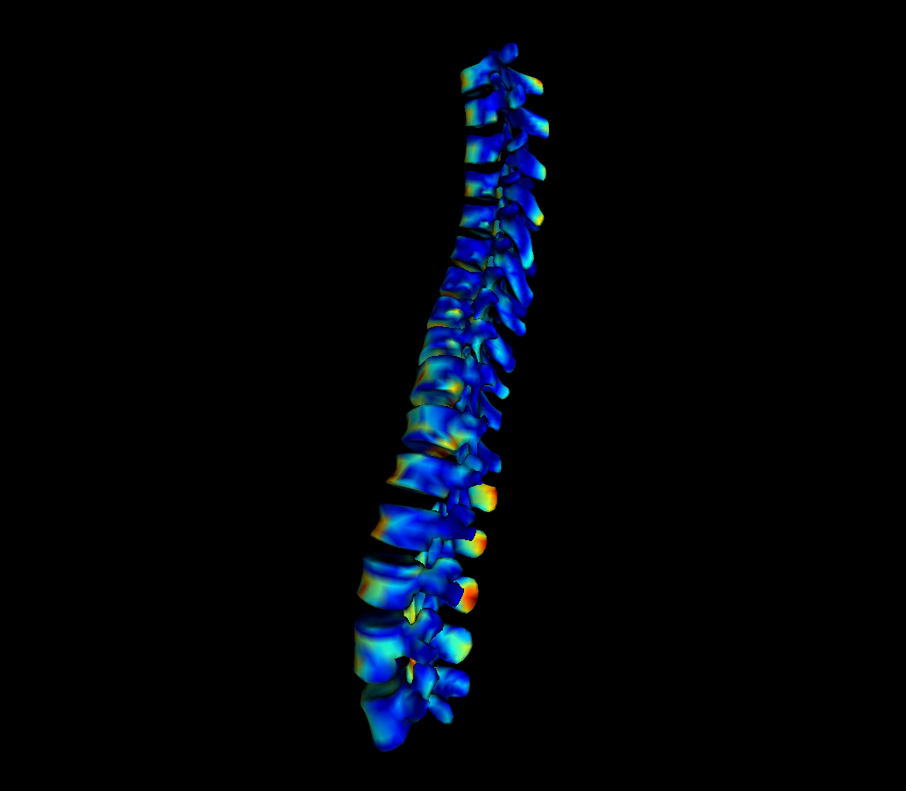
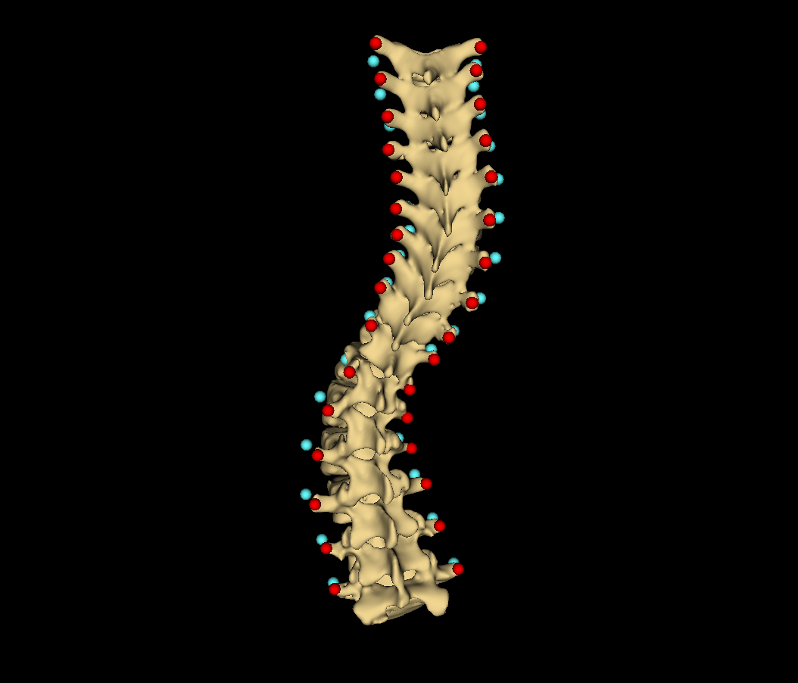
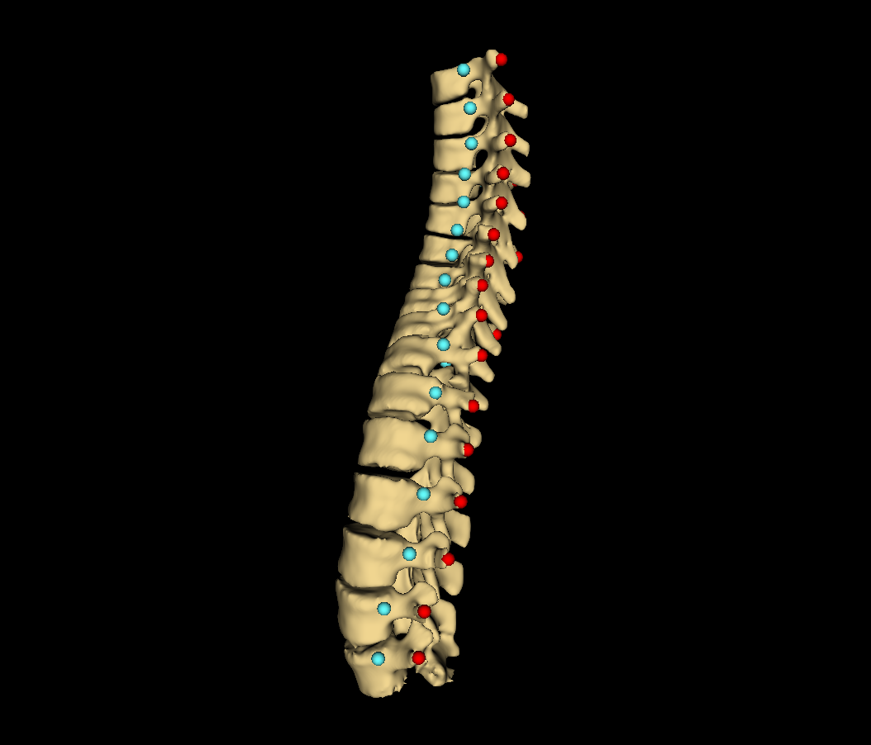

Slide 21
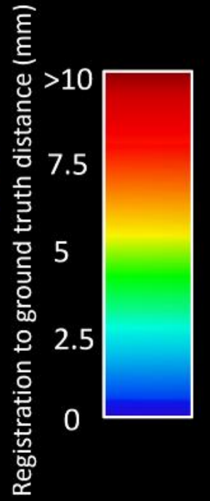
Distance map
Ground truth
Patient #
Registration to ground-truth distance (mm)
>10
2
7.5
3
5
8
2.5
13
0

Slide 22
Automatic landmark generation (Ch. 4)
Tracked ultrasound scan (2.3)
Bone segmentation (4.1)
Landmark generation (4.2)
Landmark set repair (4.3)
Scoliosis visualization (Ch. 3)
Healthy-shaped surface and landmarks (3.3)
Thin-plate spline registration (3.4)
Transverse process locations (3.2)
3D surface visualization (3.5)

Slide 23
PLUS
3D Slicer
PLUS Server
Image acquisition
Image processing and segmentation
IGTLink Server
IGTLink Client
Tracked ultrasound scan
Segmentation as label map

Slide 24
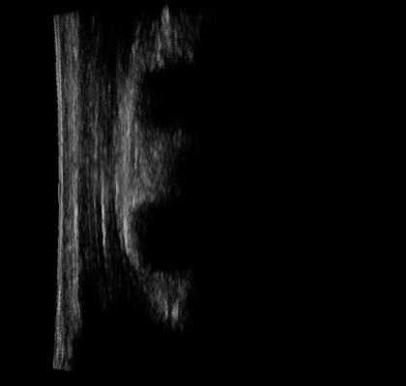





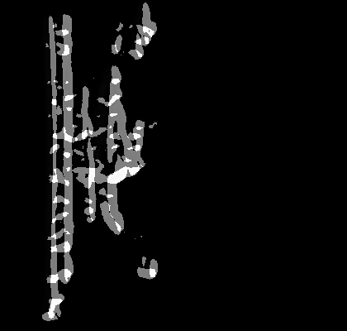

a
e
b
f
c
g
d
h

Slide 25

a
b
c

Slide 26


Slide 27
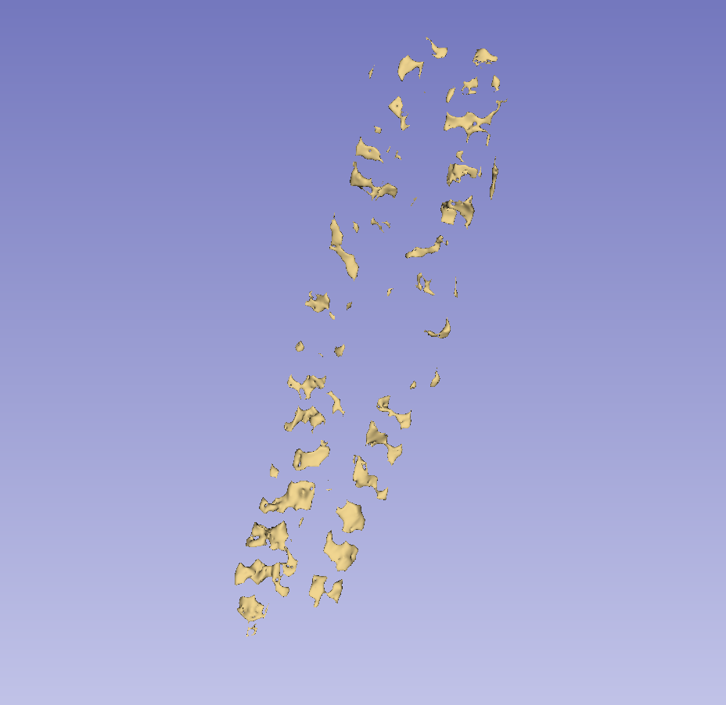
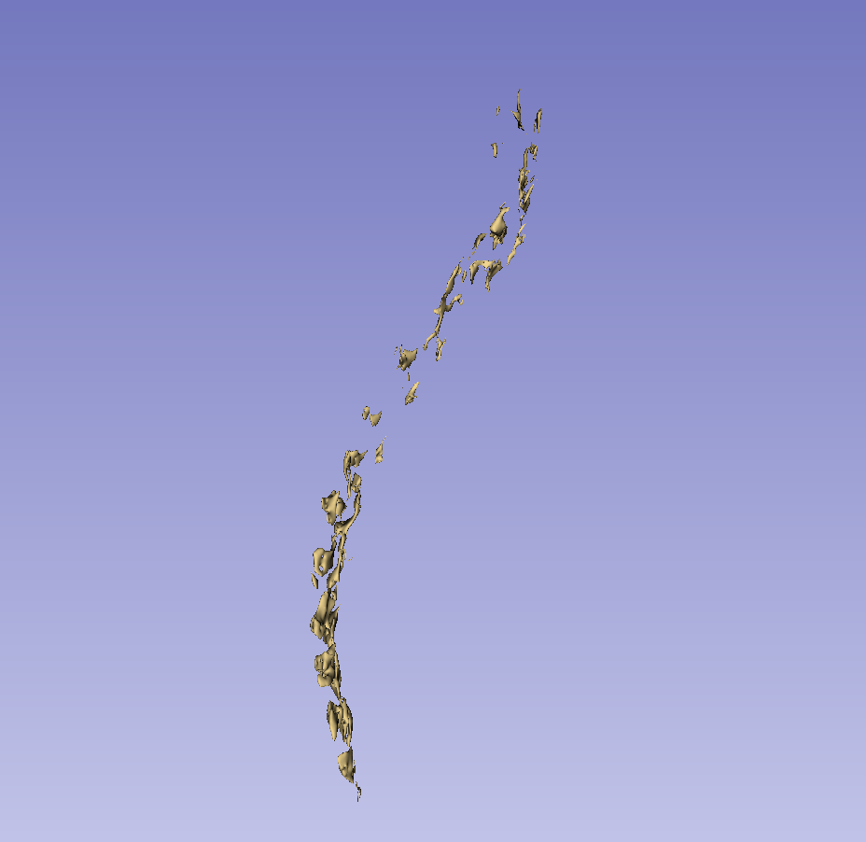

Slide 28
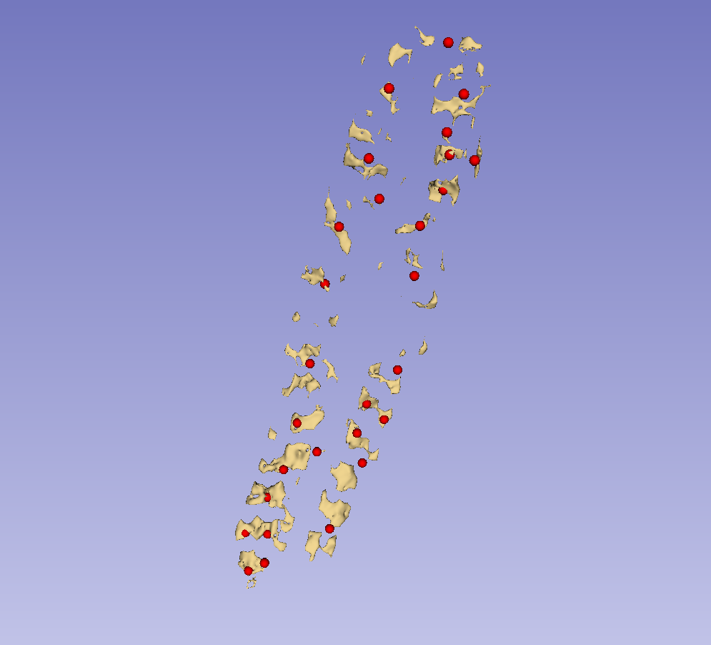

Slide 29
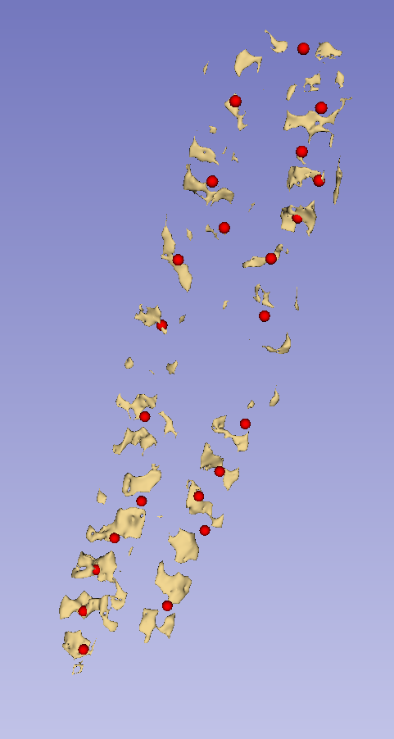

Slide 30
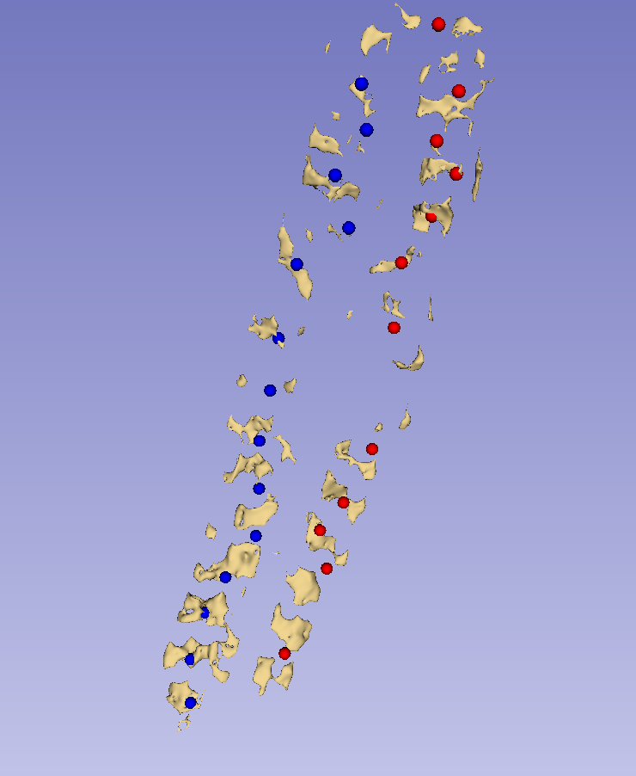
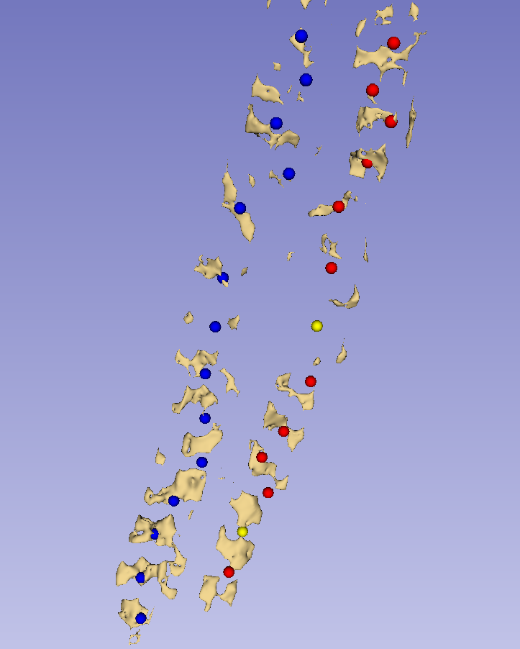
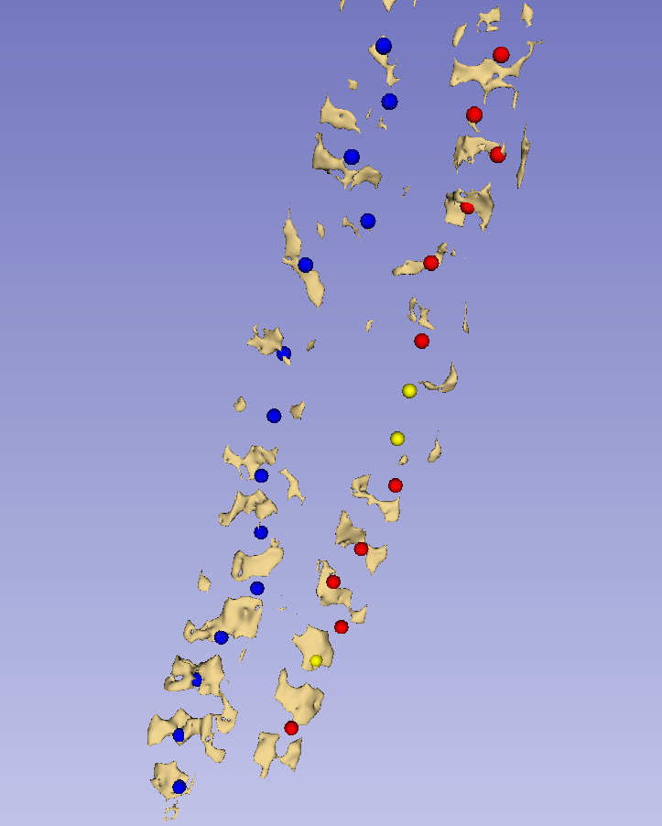
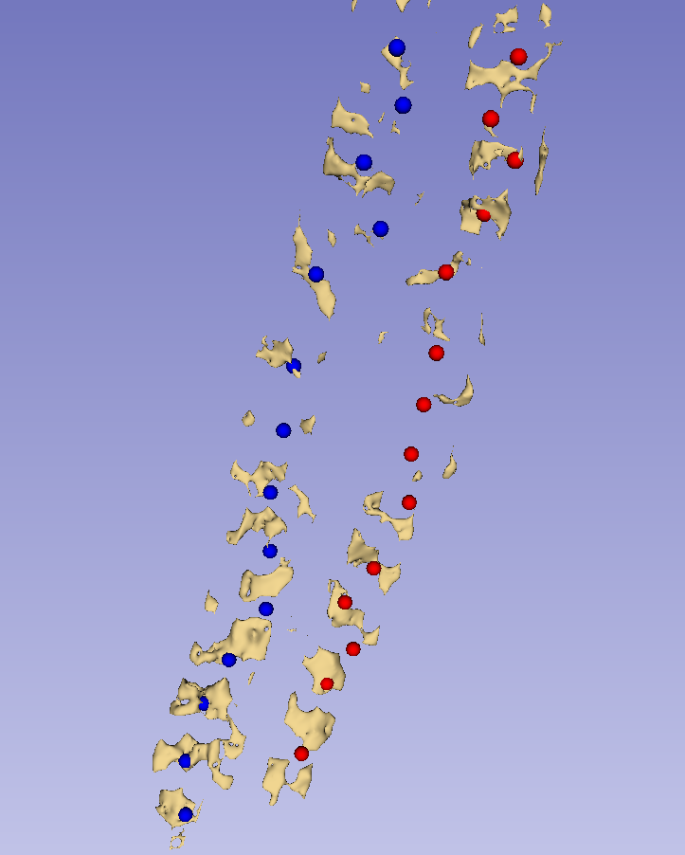
a
b
c
d

Slide 31
a
b
c

Slide 33
Reference direction
Candidate direction
Candidate direction
Reference direction
a
b
c

Slide 34
θ₁
V_{c1}
V_{ref}
θ₂
θ₁
V_{c1}
V_{c2}
V_{ref}
V_{c2}
θ₂
a
b
c

Slide 35
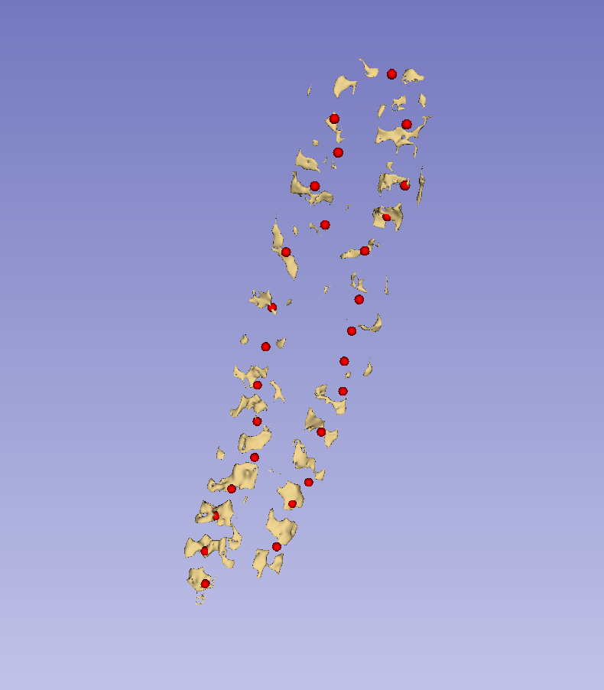
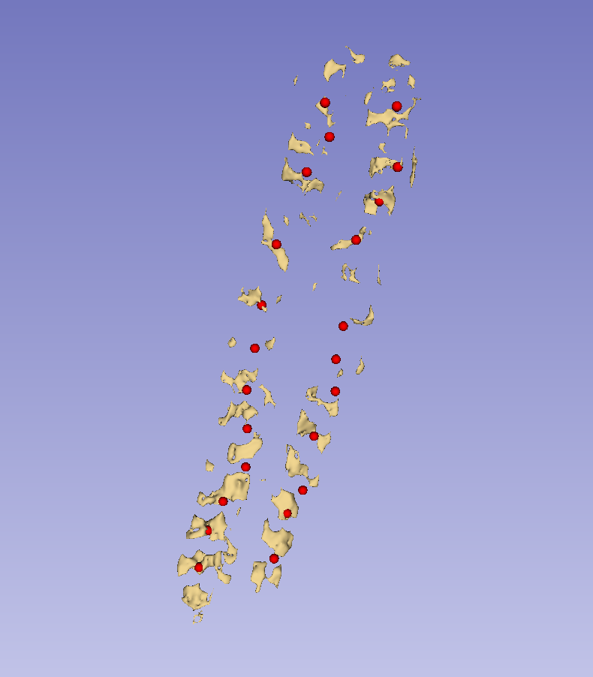
a
b
c

Slide 36



Slide 37
Automatic landmark generation (Ch. 4)
Tracked ultrasound scan (2.3)
Bone segmentation (4.1)
Landmark generation (4.2)
Landmark set repair (4.3)
Scoliosis visualization (Ch. 3)
Healthy-shaped surface and landmarks (3.3)
Thin-plate spline registration (3.4)
Transverse process locations (3.2)
3D surface visualization (3.5)

